Slide 1





CARE-AI
Causal Adaptive Reasoning for Effective Hospital Admission Interventions
Karl H. Johansson, Professor
M. Umar B. Niazi, Postdoc
Amir M. K. Mamaghan, PhD Student
Wouter Jongeneel, Postdoc
Patrik Lyngå, Ph.D., Docent, Senior Lecturer & Nurse
Södersjukhuset Cardiology
Raffaele Scorza, M.D., Ph.D., Researcher & Senior Physician Södersjukhuset Cardiology
Jenny Censin, M.D., Ph.D.,
Senior Consultant Sirona Health Solutions
Kick-off Meeting, Nov 27

Slide 2
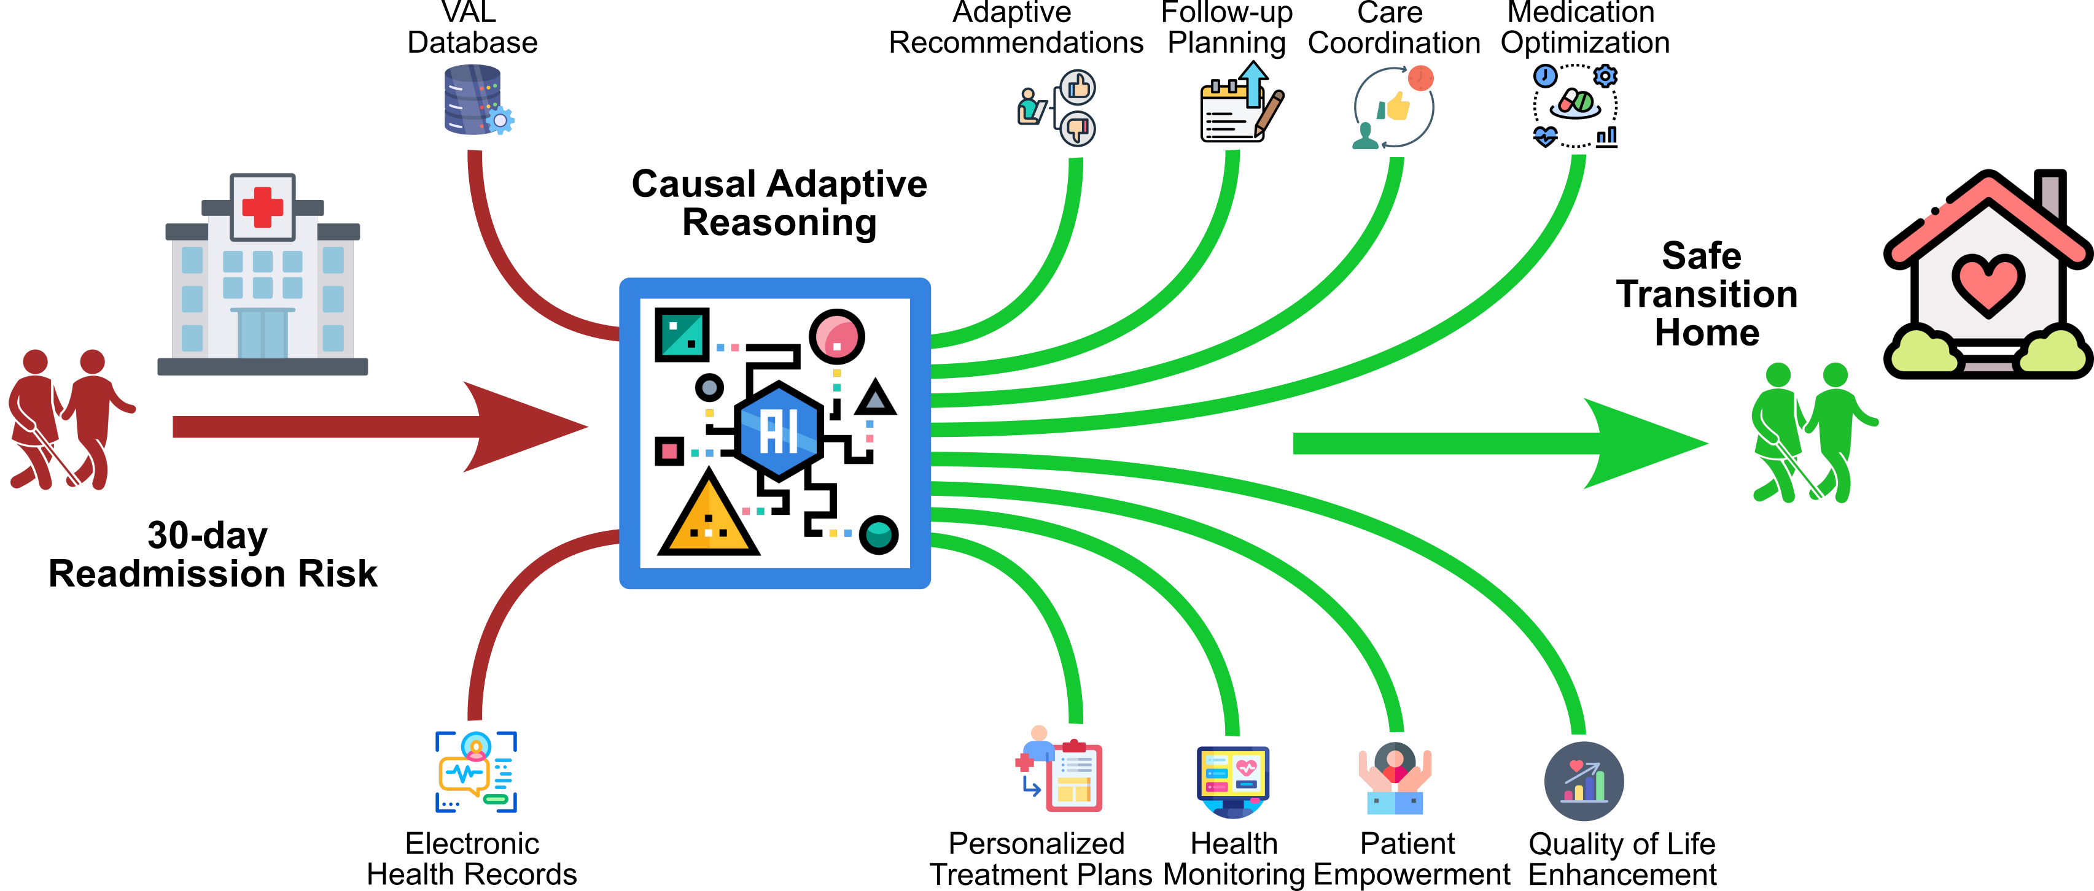
CARE-AI Project
Predictive analytics: Typically identifies who is at risk, but not what actions to take.
Proposal
CARE-AI proposes causal adaptive reasoning to answer:
“Which modifiable factors are causing hospital readmissions?”
“Which interventions will help patients avoid readmission?”
By advancing from correlation to causation, our approach recommends personalized, interpretable interventions that drive meaningful clinical outcomes.

Slide 3



Clinical Decision Support System
CARE-AI will be a clinical decision support system designed to assist doctors during the discharge process.
It analyzes data and patient histories to identify the root causes of readmissions.
It simulates potential futures to identify the best intervention.
Note for Clinicians:
The system does not replace clinical judgment. It provides evidence-based suggestions ("Human-in-the-loop").
It acts as a "second opinion" based on thousands of similar historical cases.

Slide 4
How the System would Work (Patient Flow)
The operational view of CARE-AI in a hospital setting:
Patient Admission
EHR Data Entry
CARE-AI Analysis
Matches patient to modifiable risk factors
Recommendation
"Suggested: Medication Review"
Clinician Decision
Accept / Modify / Reject
Example Scenario:
Patient X (82, Heart Failure) is ready for discharge.
CARE-AI flags high readmission risk due to "Medication Adherence."
System suggests: "Enroll in Home Care Monitoring Program."
Doctor reviews and approves the referral.

Slide 5
How the System Decides?
Standard AI finds patterns (Correlations): Probability of readmission given patient features, P(Y | X)
CARE-AI looks for causes (Causality): Probability of readmission if we modify a certain feature, P(Y | do(X))
1. Causal Discovery
“What is driving the risk?”
It separates noise (e.g., “Patient is elderly”) from actionable causes (e.g., “Patient lacks home support”).
2. Impact Estimation
“What works for THIS patient?”
It calculates the personalized benefit. Intervention A might work for Patient X, but Intervention B is better for Patient Y.
3. Optimal Care Path
“When is the right time?”
It plans the sequence of the most beneficial interventions over time to minimize readmission risk, i.e., an optimal, individualized policy.

Slide 6
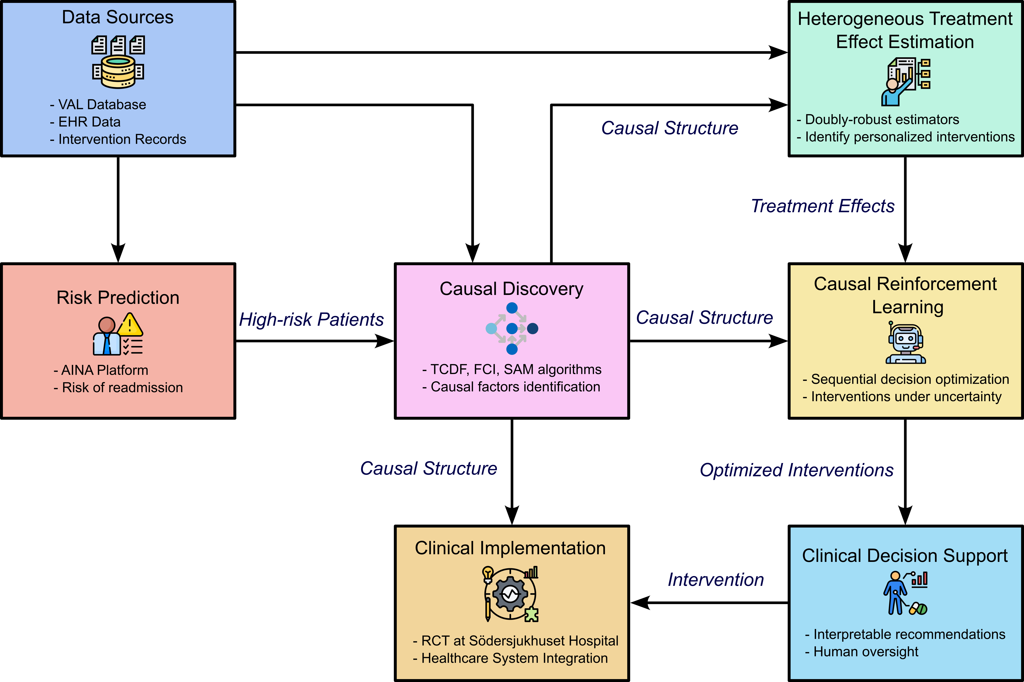
Methodology
Risk Prediction Identify high-risk patients from data
Causal Discovery Identify modifiable factors causing readmissions
HTE Estimation Estimate heterogeneous treatment effects
Causal RL Suggest optimal targeted interventions
Notes:
This project is part of a larger vision that includes clinical trials and aims to integrate with existing clinical workflows.
In this DF project, we focus on the methodological and algorithmic aspects, including causal discovery, HTE estimation, and causal RL.
Causal discovery identifies modifiable factors in patients’ data that may cause readmission. HTE estimation quantifies the benefits of different healthcare interventions across different patient groups. Causal RL provides a sequential decision-support system for a clinician to implement optimal healthcare interventions at optimal times.

Slide 7
Virtual Clinical Trial
Simulate thousands of patient journeys to ensure the AI's recommendations are safe and effective.
Represents the ground truth and patient reality
Identifies causal graphs and suggests interventions
CARE-Sim
(Virtual Environment)
CARE-AI
Patient Data
Virtual Patients
Risk Analysis
Outcome / Validation
Trajectory Simulator
Intervention Plan
Simulated Action
Challenge: How do we develop a generative model of patient health trajectories that are plausible (i.e., based on clinical logic priors) to serve as a rigorous 'Ground Truth' for our AI, while ensuring it remains statistically faithful to the real data?

